Slide 1
NAMING

Slide 2
IDENTIFIERS
A name in a distributed system is a string of bits or characters that refers to an entity
Entity : a thing with distinct and independent existence
Hosts, printers, disks, files, web pages

Slide 3
Three types of names
Address: the name of an access point to an entity
Identifier: An identifier refers to at most one entity
• Each entity is referred to by at most one identifier
• An identifier always refers to the same entity
Human-friendly name: • E.g. unix file name, DNS names

Slide 4
EXAMPLE
– Telephone as Access Point to a person
– The Telephone Number then becomes the address of the person.
– Person can have several telephone numbers.
– Entity can have several addresses.

Slide 5
DIFFERENT ACCESS POINTS
Using address to refer to an entity is
Inflexible, human unfriendly, subject to changes
an entity changes address, address reassigned to another entity
An entity has more than one address (access point), which one to use as a reference?
Easier and more flexible to use location independent names

Slide 6
identifier
Identifiers are used to uniquely identify an entity.
An identifier is a name with the following properties:
– An identifier refers to at most one entity
– Each entity is referred to by at most one identifier
– An identifier always refers to the same entity (i.e., it is never reused)

Slide 7
examples
Media Access Control address, better known as MAC address, is a unique identifier assigned to a network adapter or network interface card (NIC) by the manufacturer for identification

Slide 8
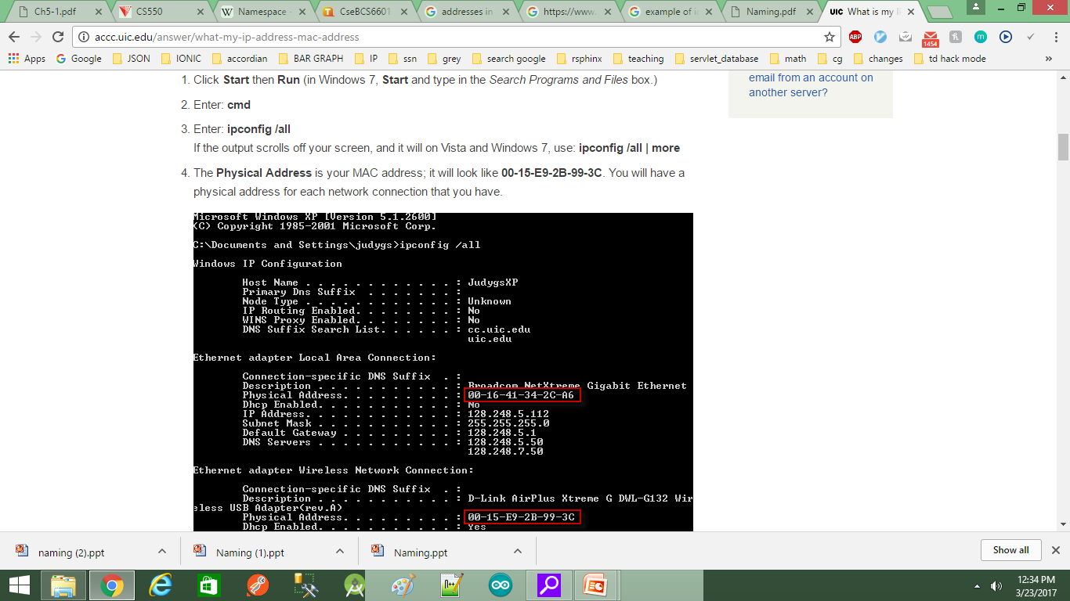

Slide 9
BRUSH THROUGH ON NAME SPACES
a namespace is a set of symbols that are used to organize objects of various kinds, so that these objects may be referred to by name
Names are always organized in a name space

Slide 10
REPRESENTATION
The name space is represented as a labeled directed graph with two types of nodes
– A leaf node represents a file and stores information about the file (e.g., owner, last modification time, location of data blocks, etc.) – A directory node represents a file directory and stores a directory table of (edge label, node ID) pairs

Slide 11
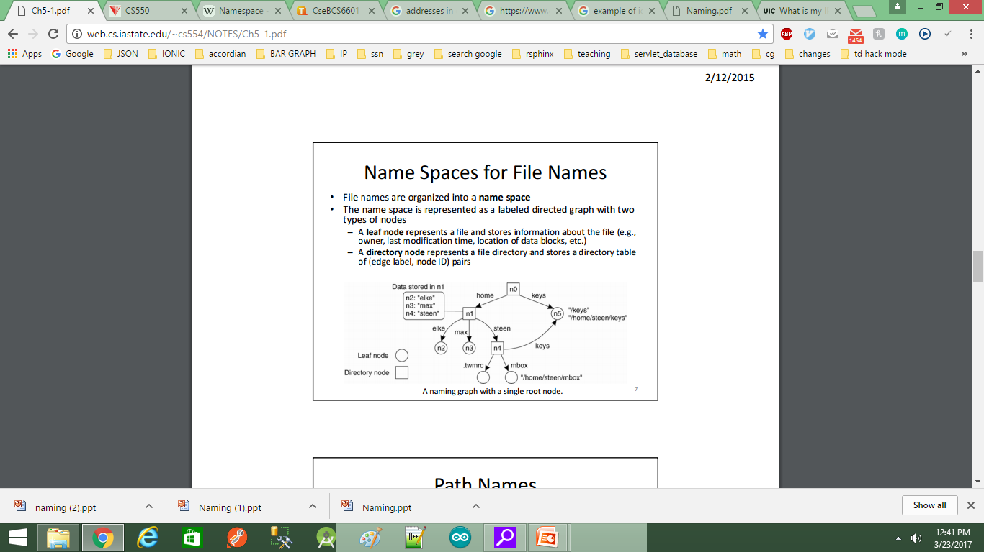

Slide 12
Name resolution
the process of looking up a name
Name resolution is performed by traversing the naming graph
– Resolution of absolute path names starts from the root node
– Resolution of relative path names starts from the current directory node (e.g., current directory for steen/mbox is home)

Slide 13
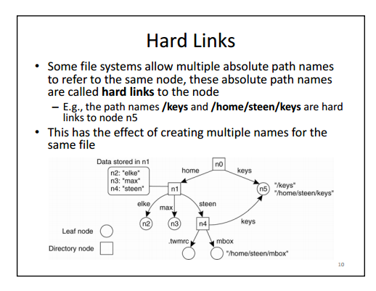

Slide 14
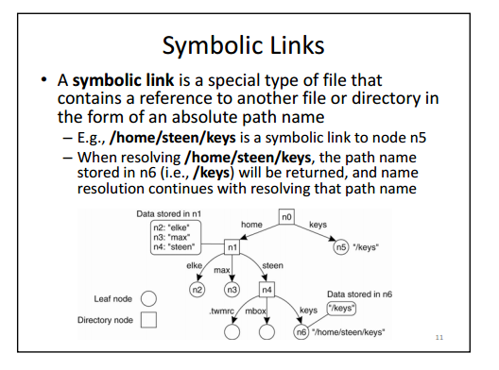

Slide 15
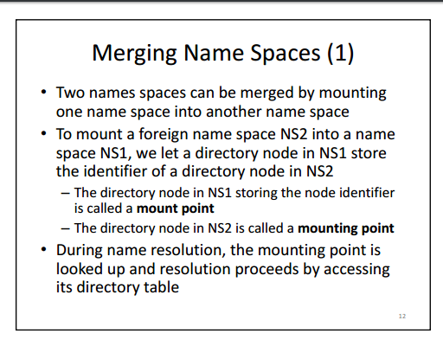

Slide 16
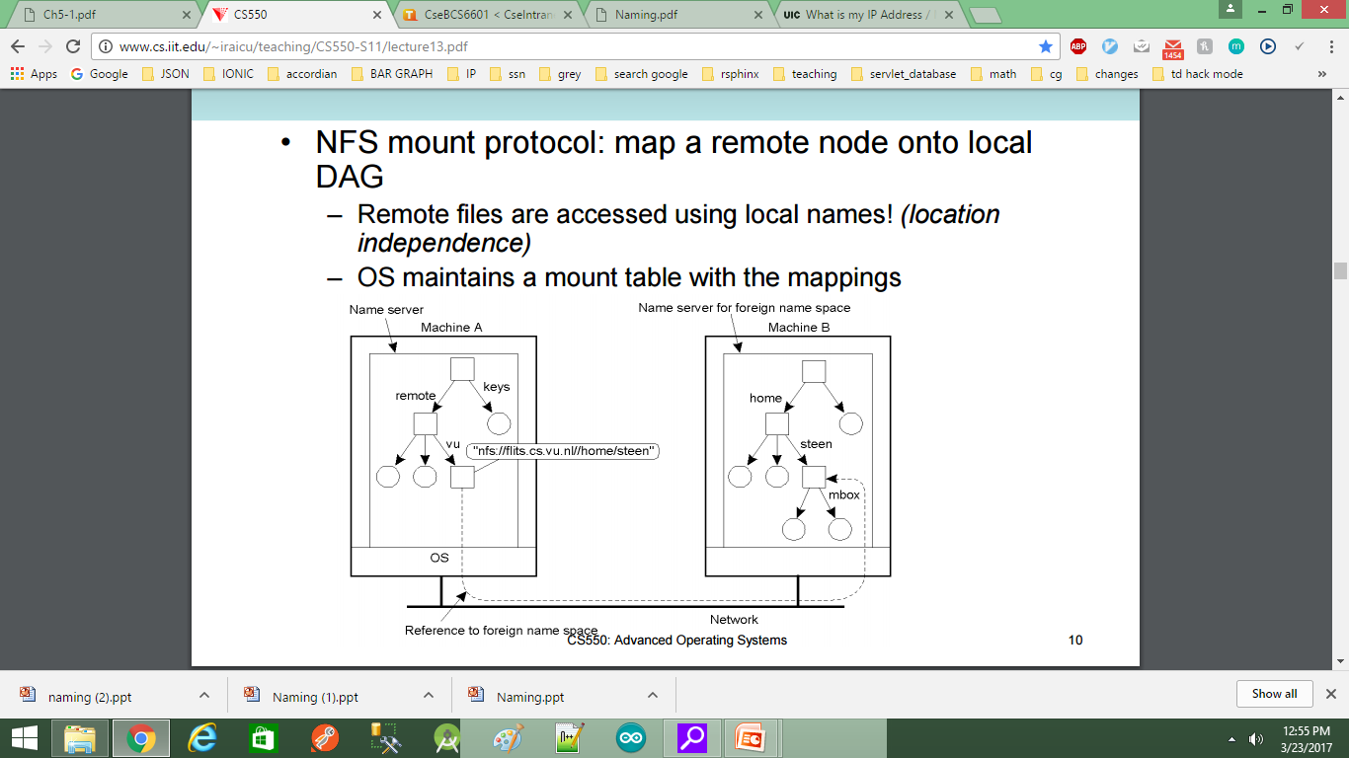

Slide 17
